Slide 1
Microsoft Learn Spark possibility
© 2025 Microsoft Corporation. All rights reserved.

Slide 2
Girl Scouts of Colorado x Microsoft Patch Program
Explore AI
© 2025 Microsoft Corporation. All rights reserved.

Slide 3
What is Generative AI?
Generative AI is a branch of artificial intelligence focused on creating new content. Unlike traditional AI, which might classify or predict based on data, generative AI can produce original outputs such as images, text, music, and more. It’s like working with a digital artist or writer that learns from examples and then creates something new
Examples
Ethics and Responsibility
Art and Design: AI can create unique artworks, design logos, and even generate fashion designs
Music: AI can compose original music pieces or help musicians create new sounds
Writing: AI can write stories, poems, and even help with homework by generating ideas and content
Games: AI can design game levels, characters, and even entire game worlds
Using AI Responsibly: It’s important to use AI in ways that are ethical and respectful. This means not using AI to create harmful or misleading content
Privacy and Consent: Always respect people’s privacy and get permission before using their data
Bias and Fairness: Be aware that AI can sometimes reflect biases in the data it was trained on. It’s important to recognize and address these biases
© 2025 Microsoft Corporation. All rights reserved.

Slide 4
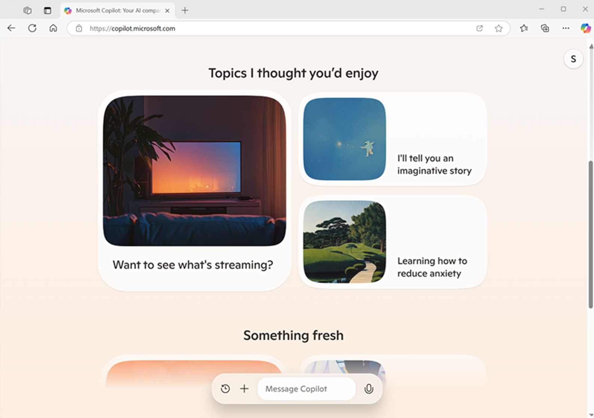
What is Microsoft Copilot?
We asked it – here’s what it said…
Microsoft Copilot is like having a versatile assistant ready to help with a wide range of tasks. Here are some of the things I can do:
Answer Questions: Got a question about your homework or something you’re curious about? I can help you find the answers
Brainstorm Ideas: Need cool ideas for a school project, a story, or a presentation? Let’s come up with awesome ideas together
Write Content: Whether it’s writing an email, creating a document, coding, or making up stories and poems, I can help you out
Organize Tasks: Need help keeping track of your to-do list or planning your schedule? I can help you stay organized
Research: I can look up information online, explain tricky topics, or give you the latest news and updates
Generate Images: Describe a picture you need, and I can create one for you (within certain guidelines)
Engage in Conversation: Want to chat about your favorite hobbies, games, or just have a friendly conversation? I’m here for that too
© 2025 Microsoft Corporation. All rights reserved.
Notes:
Microsoft Copilot is an AI-powered assistant that you can interact with on the Microsoft Copilot web site, the Copilot pane in Microsoft Edge, apps for mobile devices, and other interfaces.
The slide displays the literal response from Microsoft Copilot when asked what it can do.

Slide 5
How does Microsoft Copilot work?
Through the power of generative artificial intelligence
Prompt
My mom and I are going to London to visit my cousin. Give me ideas for things to appreciate and do in London
Training data
London is a city brimming with history, culture, and excitement! Here are some ideas for things to appreciate and do:
Buckingham Palace: Tour the State Rooms and witness the Changing of the Guard ceremony
Tower of London: Explore the historic castle and appreciate the Crown Jewels
…
Microsoft Copilot
Large Language Model (LLM)
© 2025 Microsoft Corporation. All rights reserved.
Notes:
Microsoft Copilot is built on generative AI and uses a large language model (LLM) that has been trained with huge volumes of text. An LLM is a special kind of machine learning model that represents semantic relationships between words and phrases – enabling it to generate grammatically correct language in response to prompts (natural language input – often in the form of a question or instruction). The vast volume of data with which the model was trained gives it a huge general knowledge base on which to base its responses and enables it to respond in way that is often indistinguishable from a human.

Slide 6
Guidelines for effective prompts
Summarize the article at https://nodpublishers.com/London¹ as a bulleted list of 3 to 5 interesting facts² to help me plan a trip³. Keep each bullet concise and simply worded⁴
Here are some interesting facts about London to help you plan your trip:
Historical Roots: Founded by the Romans as Londinium in AD 47
…
How easy is it to get around the city?⁵
Provide a source to ground the response in a specific scope of information if available
State a specific goal for what you want the copilot to do
Add context to maximize response appropriateness and relevance
Set clear expectations for the format of the response
Iterate based on previous prompts and responses to refine the result
© 2025 Microsoft Corporation. All rights reserved.
Notes:
While some copilots provide buttons and other visual tools to interact with a language model, often you will use a copilot by typing (or speaking) a natural language prompt. A prompt is the way that you interact with a large language model.
The specific prompt that will yield the most effective results can vary depending on the specific task you’re trying to accomplish, the copilot being used, and the language model it uses to support generative AI. However, there are some common prompting techniques you can apply to get the best out of your copilot:
Provide a source to ground the response in a specific scope of information if available
State a specific goal for what you want the copilot to do
Add context to maximize response appropriateness and relevance
Set clear expectations for the format of the response
Iterate based on previous prompts and responses to refine the result
Microsoft Copilot does not just send your prompt as-is to the language model. Usually, your prompt is augmented with:
A system message that sets conditions and constraints for the language model behavior.
The conversation history for the current session, including past prompts and responses – this enables you to refine the response iteratively while maintaining the context of the conversation
The current prompt – potentially optimized by the copilot to reword it appropriately for the model or to add additional grounding data.to scope the response.
The success you have with copilots (and generative AI in general) depends largely on how well you craft your prompts. The importance of using good prompts has led to a new discipline of prompt engineering.

Slide 7
About the Patch Program: Design a dream destination with AI
Today, you’ll learn how to work with AI tools
You will discover some amazing things AI tools like Microsoft Copilot can do, and you will learn and practice the skills to work with them
You’ll use your imagination and creativity to come up with a new place and create the content using Generative AI to tell its story
By the end of this program, you will have created a unique destination from your imagination that includes visual representations, menu outline, music and ambiance features, and a name and brand outline of your dream destination
© 2025 Microsoft Corporation. All rights reserved.

Slide 8
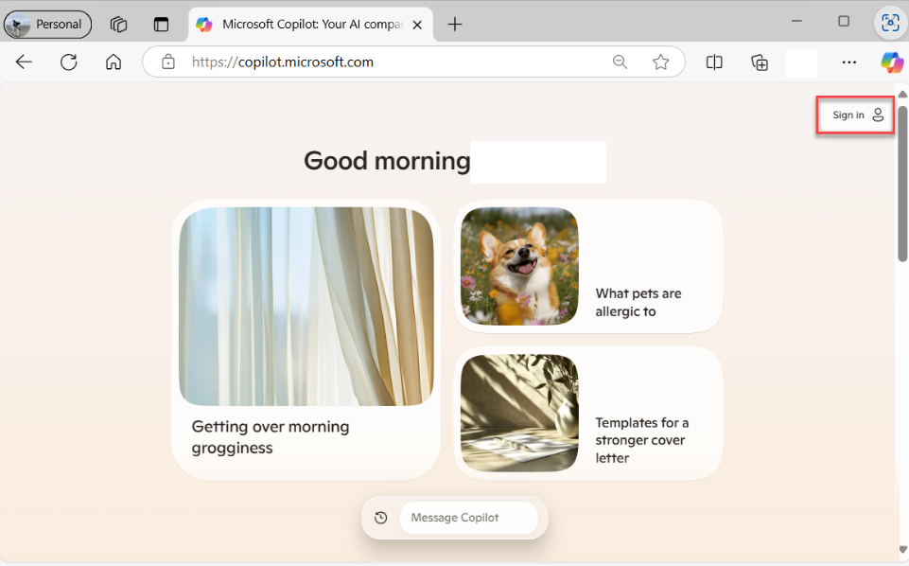
Unit 1: Getting Started
1 | Open your browser and go to copilot.microsoft.com
2 | Sign into Copilot with your personal Microsoft account
3 | If you do not have an account, follow these steps to create one Go to the Microsoft account sign-up page: Visit account.microsoft.com Select “Create account“: You’ll find this option on the sign-in page Enter your email address: You can use an existing email or create a new Microsoft Outlook email Create a password. Make sure it’s strong and secure Enter your personal details: Fill in your name, country/region, and birthdate Verify your email: Microsoft will send a verification code to your email. Enter this code to verify your account Complete the CAPTCHA. This step ensures you’re not a robot Agree to the terms: Read and accept Microsoft’s terms and conditions
© 2025 Microsoft Corporation. All rights reserved.

Slide 9
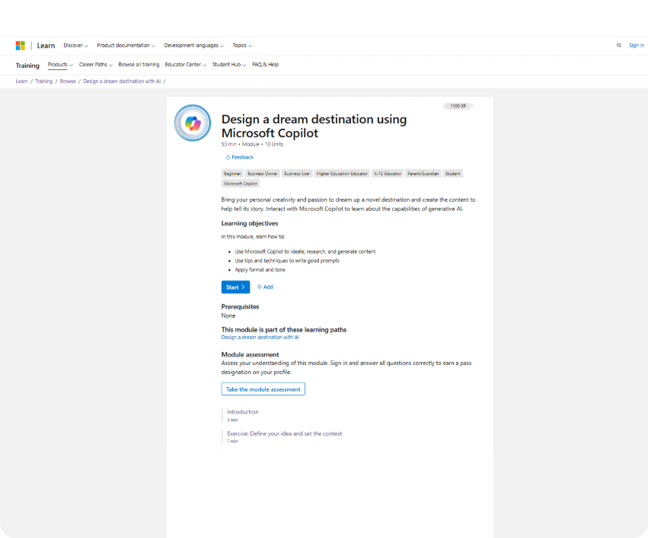
Unit 1: Getting Started
1 | Open a new tab in your browser
2 | Navigate to aka.ms/Explore-AI
3 | You have already completed the steps in Unit 1 with logging in, navigate to Unit 2
© 2025 Microsoft Corporation. All rights reserved.

Slide 10
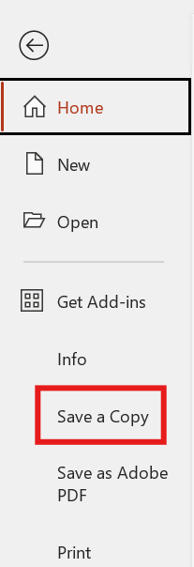
Unit 1: Getting Started
1 | Open the Microsoft PowerPoint “GSCO_Explore AI_Presentation”
2 | Follow these steps to create a copy of the file for you to edit:
 | File Save a copy Into the “Save As” box add your last name or initials to the file name Select save
© 2025 Microsoft Corporation. All rights reserved.

Slide 11
Unit 2: Define your idea and set the context
For this exercise we are going to be working on defining and refining our ideas for an AI-generated destination
Follow the steps in Unit 2, to set the stage for you dream destination
1
2
3
Use a role-based prompt
Define your idea
Introduce your idea
© 2025 Microsoft Corporation. All rights reserved.

Slide 12
Unit 2: Create your own role-based prompt to define the experience designer
You’re an extraordinary experiential designer and you possess a unique talent for crafting immersive experiences that ignite the senses and transport patrons into a realm of pure magic
Through a masterful combination of captivating soundscapes, mesmerizing visuals, and carefully curated environmental conditions, you orchestrate extraordinary journeys that both delight and intrigue
Your creative prowess knows no limits as you dream up audacious ideas that awaken the imagination, while also meticulously tending to the smallest sensory details that seamlessly weave together a thematic tapestry
With your remarkable ability to engage multiple senses, you have the power to create unforgettable moments that envelop individuals in a symphony of sensations, leaving them spellbound, delighted, and yearning for more. You’ll be helping to assist in the creation of a new experience
© 2025 Microsoft Corporation. All rights reserved.

Slide 13
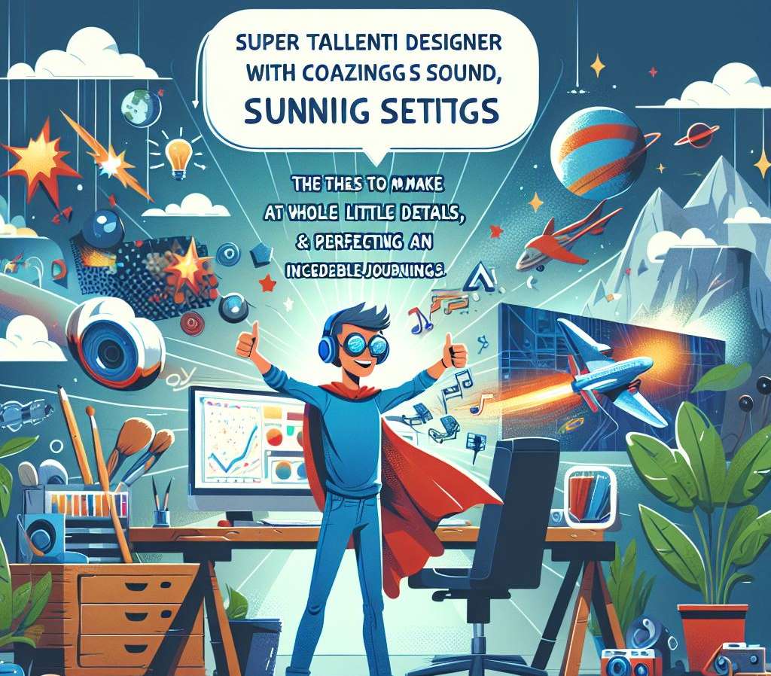
Unit 2: Create your own role-based prompt to define the experience designer
Imagine you’re a super talented designer who can create amazing experiences that feel like magic. You use cool sounds, stunning visuals, and perfect settings to take people on incredible journeys that they will never forget.
You come up with awesome ideas that spark the imagination and pay attention to every little detail to make everything fit together perfectly. You have the power to make people feel like they’re in a whole new world, leaving them amazed and wanting more.
This image was created in Copilot with Microsoft Designer using the words provided as a prompt
© 2025 Microsoft Corporation. All rights reserved.
Notes:
This image was created in Copilot with Microsoft Designer using the words on the left.
Why do you think that the words might be misspelled?
Answer from Copilot:
The misspelled words in the images are likely due to the limitations of the image generation model. These models sometimes struggle with accurately rendering text, especially when creating complex or artistic images.
If you need to explain this to others, you can mention that the focus of the image generation was on the visual and thematic elements rather than precise text accuracy. The primary goal was to capture the essence of a character who is a talented designer, creating magical experiences. If you need any adjustments or further assistance, feel free to let me know!

Slide 14
Unit 2: Have you ever heard of Mad Libs®?
Adjective | Noun | Verb
Amazing | Adventure | Jump
Bold | Beach | Run
Creative | Castle | Dance
Exciting | Forest | Explore
Fantastic | Game | Build
Magical | Hero | Discover
Mysterious | Journey | Imagine
Unique | Mountain | Create
Vibrant | Robot | Invent
Wild | Space | Fly
Mad Libs® are a fun and interactive word games where you fill in the blanks of a story with different types of words, such as adjectives, nouns, and verbs. The result is often a hilarious or unexpected story. We’re going to use this structure to help us craft our prompts in Unit 2.
"Mad Libs®" is a registered trademark of Penguin Group (USA) Inc. This does not reflect an endorsement or affiliation with the trademark owner and is used for educational purposes only.
© 2025 Microsoft Corporation. All rights reserved.
Notes:
"Mad Libs®" is a registered trademark of Penguin Group (USA) Inc. This does not reflect an endorsement or affiliation with the trademark owner and is used for educational purposes only.

Slide 15
Unit 2: Example of a different role-based prompt
You’re an amazing experience designer with a special talent for creating immersive worlds that excite the senses and
transport people into a magical realm.
Using a mix of awesome sounds, stunning visuals, and carefully chosen environmental details, you create incredible
journeys that both amaze and entertain.
Your creativity knows no bounds as you come up with bold ideas that spark the imagination, while also paying attention
to the smallest details that bring everything together.
With your ability to engage multiple senses, you can create unforgettable moments that surround people in a
symphony of sensations, leaving them amazed, happy, and wanting more. You’ll be helping to create a new, exciting
experience.
(Adjective)
(Adjective)
(Verb)
(Adjective)
(Adjective)
(Adjective)
(Noun)
(Adjective)
(Verb)
(Adjective)
(Noun)
(Adjective)
(Noun)
(Adjective)
(Adjective)
(Adjective)
© 2025 Microsoft Corporation. All rights reserved.

Slide 16
Unit 2: Define your Idea
New destination experience
Cozy, secluded restaurant located deep in the woods
This restaurant is high above the ground and built into the branches of a tree
Thematically, it’s organic nature meets invitation-only destination
Mysterious and hidden
(Adjectives)
(Place)
(Location)
I have an idea that I want to work on for this project and I will provide some bullet points. Can you help me create a paragraph with a travel marketing tone and embellish on details that really bring this idea to life?
It should capture the following points. Do not give this destination a name. Focus on what makes this destination unique. We will brand and name this experience later
(Place)
(Location)
(Theme or aesthetic)
(Adjective)
Common Places | Theme or Aesthetic | Location
Library School Coffee shop Amusement park Museum Beach Mall Farm Castle Treehouse | Steampunk Cyberpunk Vintage Minimalist Rustic Fairy tale Industrial Tropical Space-age Art Deco | On a mountain peak In a desert oasis Inside a volcano On a floating island In a bustling city In a snowy tundra On a pirate ship In a magical forest On another planet In a hidden cave
© 2025 Microsoft Corporation. All rights reserved.

Slide 17
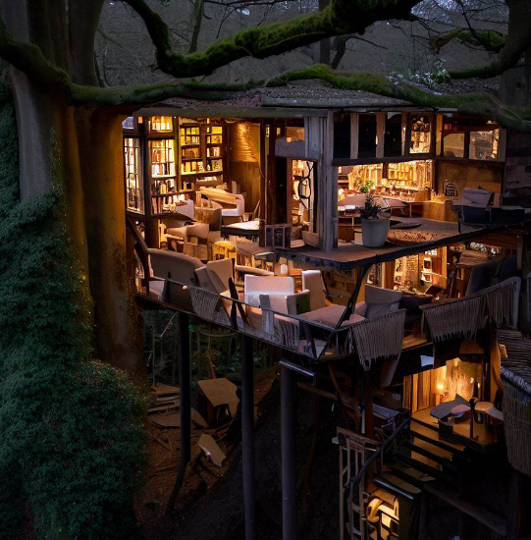
Unit 3: Create your hero image
In this exercise we are going to take the detailed description you just created for your dream destination and turn it into a visual representation. Follow the steps in Unit 3 for creating your image
Steps:
Copy the sample prompt from Microsoft Learn
Paste the prompt into the chat
Prompt Copilot to make changes to your image until you’re happy with the result
Download the image and paste it into your PowerPoint slide titled Hero Image
© 2025 Microsoft Corporation. All rights reserved.

Slide 18
Work on your own
15 Minutes
© 2025 Microsoft Corporation. All rights reserved.

Slide 19
Share out
5 Minutes
© 2025 Microsoft Corporation. All rights reserved.

Slide 20
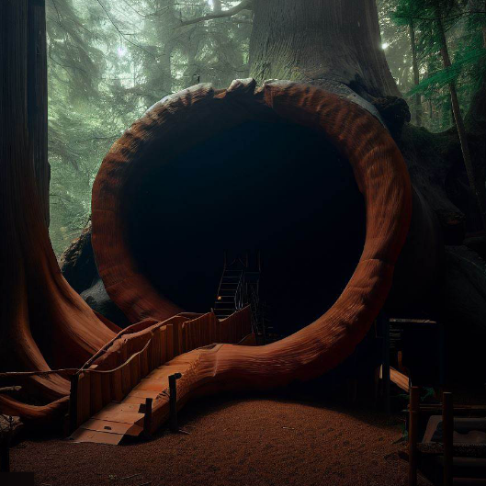
Unit 4: Make a Grand Entrance
In this exercise we are going to design an image and description for your entrance to your dream destination
Follow the steps in Unit 4, to make an epic entrance to your destination
Ideate with Copilot
Expand on the idea
Edit the description
Create an image
Download the image and paste it into your PowerPoint slide titled Grand Entrance
© 2025 Microsoft Corporation. All rights reserved.

Slide 21
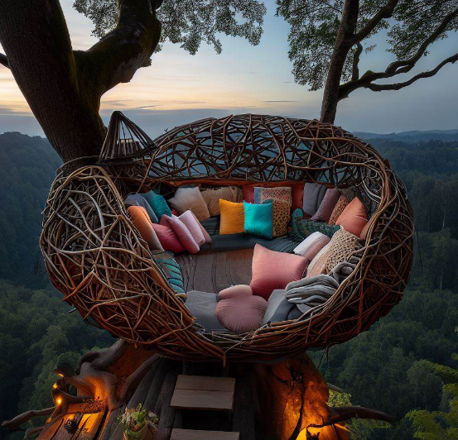
Unit 5: Brainstorm Destination Features
For this exercise use your imagination to create unique features about your destination. We’re going to ask Copilot to brainstorm ideas, and create visuals from the description
Follow the steps in Unit 5 to create key details about your destination
Ideate
Expand the ideas
Create an image
Download the image and paste it into your PowerPoint slide titled Destination Features
© 2025 Microsoft Corporation. All rights reserved.

Slide 22
Work on your own
15 Minutes
© 2025 Microsoft Corporation. All rights reserved.

Slide 23
Share out
5 Minutes
© 2025 Microsoft Corporation. All rights reserved.

Slide 24
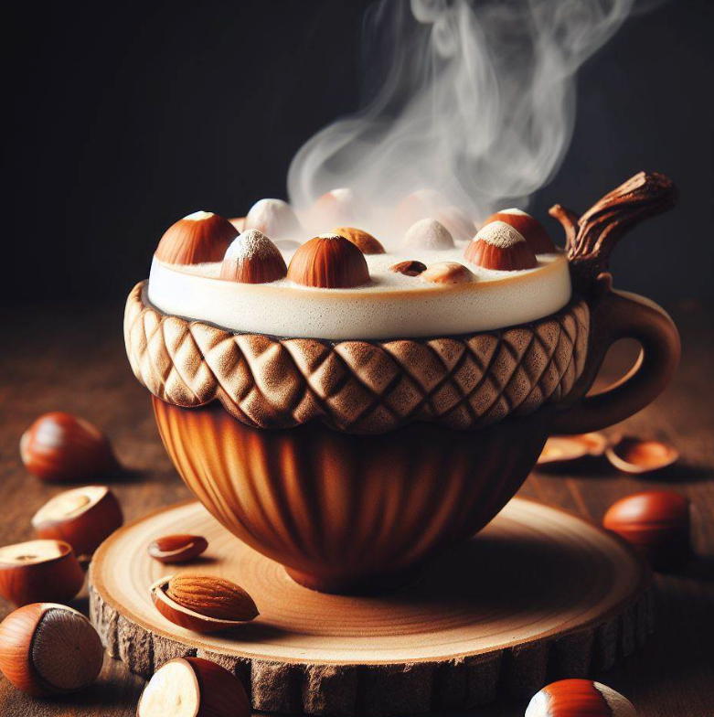
Unit 6: Plan the Menu
For this exercise we are going to create food and menu options for your destination. They can enhance the mood theme, and experience of the visitors
Follow the steps in Unit 6 to design your menu
Ideate
Generate the image
Ideate a signature drink
Ideate with Copilot
Generate your image
Ideate with a reference
Download the image and paste it into your PowerPoint slide titled Menu
© 2025 Microsoft Corporation. All rights reserved.

Slide 25
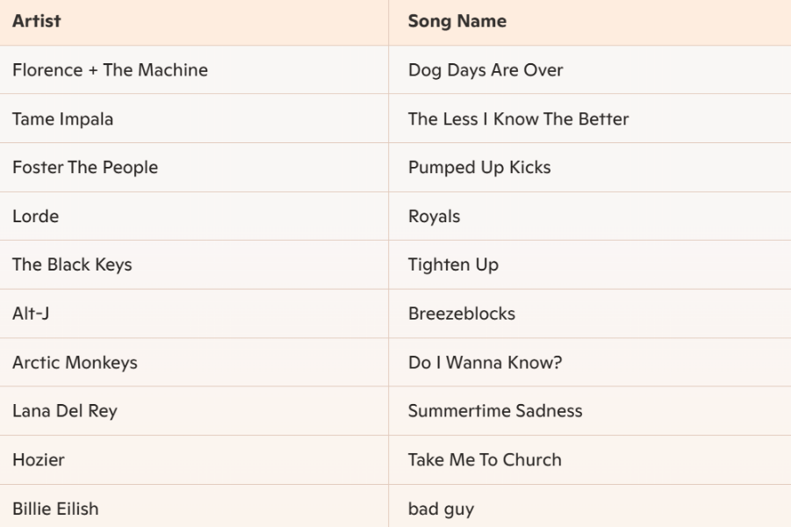
Unit 7: Ideate Ambience and Music
In this exercise we are going to work on setting the mood and atmosphere of your destination. This can help express your theme and personality! With the help of Copilot you’ll create a playlist of songs that match the vibe
Ideate
Copy the sample prompt into the chat
Review the response and edit as needed until you’re happy
Take a screen capture (Windows, Shift, S) and copy the image
Paste the image into your PowerPoint on slide titled Ambience and Music
© 2025 Microsoft Corporation. All rights reserved.

Slide 26
Unit 8: Create Branding Material
For this exercise we’re going to focus on the final aspect of our destination which is generating branding material. We’re going to create a catchy name for your destination and a short description that captures its essence
1
2
3
Ideate with Copilot
Write copy with Copilot
Copy and paste your branding materials into your PowerPoint
© 2025 Microsoft Corporation. All rights reserved.

Slide 27
Work on your own
15 Minutes
© 2025 Microsoft Corporation. All rights reserved.

Slide 28
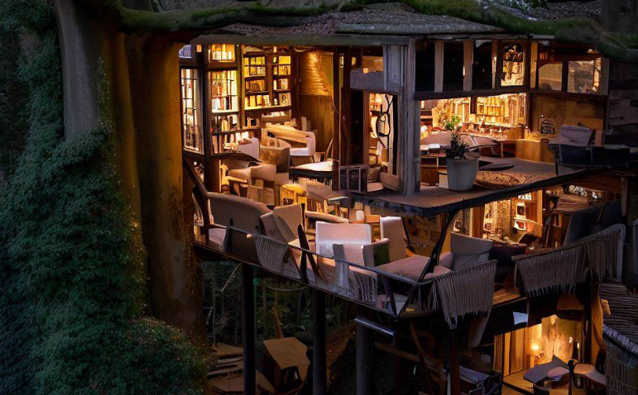
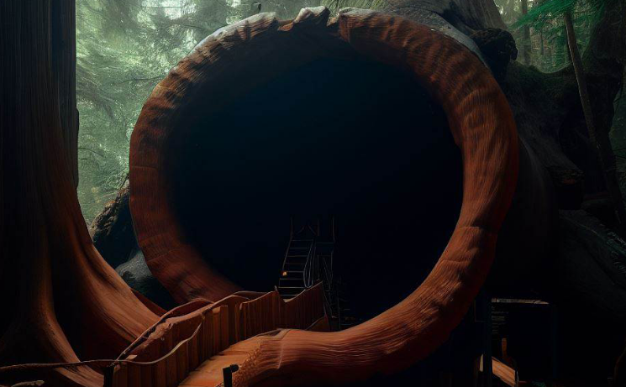
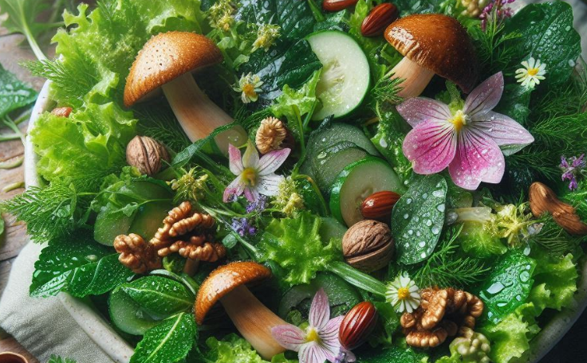
Project Debrief
Share and learn
Showcase your dream destination you created with Copilot
What did you learn about what works best with Copilot to produce what you imagined?
Can you think of other projects or tasks where Microsoft Copilot might be a great assistant?
© 2025 Microsoft Corporation. All rights reserved.
Notes:
Encourage all learners to share their results and to discuss the prompting techniques they found to be effective.

Slide 29
Knowledge check
What is the significance of providing specific details when asking Copilot to suggest a name for the destination?
To ensure that the name is long and complex
To make sure that the name includes a pun or cultural reference
To generate a name that accurately captures the essence and feel of the destination
1
What is the main benefit of using the multimodal capabilities in Copilot?
It allows the copilot to understand images shared in the chat
It allows the copilot to search the web for web related content based on the chat history
It allows the copilot to perform actions and tasks within the chat without leaving the browser
2
How do you refine image output using Copilot?
Request Copilot to create an image without providing any context
Use descriptive modifiers in the prompt and craft an image prompt with more details
Ask Copilot to generate a random image
3
© 2025 Microsoft Corporation. All rights reserved.
Notes:
Allow learners a few minutes to consider each question. Then use the slide build animations to reveal the correct answers

Slide 30
Recap
Key Takeaways
Generative AI Basics:
What You Learned: You discovered what generative AI is and how it works. You learned that it’s a type of AI that can create new content, like images, text, and music, by learning from examples
Why It Matters: Understanding generative AI helps you appreciate how technology can be used creatively and responsibly
Creating Your Dream Destination
What You Did: You used AI to brainstorm ideas, create hero images, and design features for your destination
Why It Matters: These projects showed you how AI can bring your creative ideas to life in unique and exciting ways
© 2025 Microsoft Corporation. All rights reserved.

Slide 31
Reflect and Expand: Your AI Journey Continues!
Congratulations on completing the GSCO X Microsoft Explore AI Patch Program! Let’s take a moment to reflect on what you’ve learned and think about how you can continue to explore generative AI
Reflection
Keep Exploring!
Take a moment to think about your journey through this course:
Favorite Part: What was your favorite part of the course? Was it brainstorming ideas, creating images, or something else?
What You Learned: What new skills or knowledge did you gain? How do you feel about using AI now compared to when you started?
Your journey with generative AI doesn’t have to end here. Here are some ways to keep exploring:
Explore More: Use Copilot to expand on your current ideas or start new projects. Try creating a new destination or designing a themed event
Additional Challenges: Challenge yourself with fun tasks, like creating a futuristic city or designing a magical forest
© 2025 Microsoft Corporation. All rights reserved.

Slide 32
Gaining your Patch & Survey
Congratulations on completing this patch program! You finished the Girl Scouts of Colorado x Microsoft Explore AI Patch Program. We hope you take this information about the possibilities of Generative AI and share it with your friends and family
Please visit the Anytime Activities page to request your FREE Microsoft Explore AI patch and complete the program survey!
© 2025 Microsoft Corporation. All rights reserved.

Slide 33
Microsoft Learn Spark possibility
© 2025 Microsoft Corporation. All rights reserved.

